Slide 1
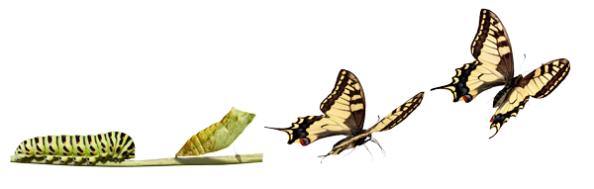
The Chrysalis Effect
When ‘ugly’ scientific findings become ‘beautiful’ scientific papers…
‘Ugly’
data
‘Beautiful'
scientific paper
Prestigious
publication
P-hacking
HARKing
O’Boyle et al. (2014)
Notes:
How does this interact with the publication system?

Slide 2
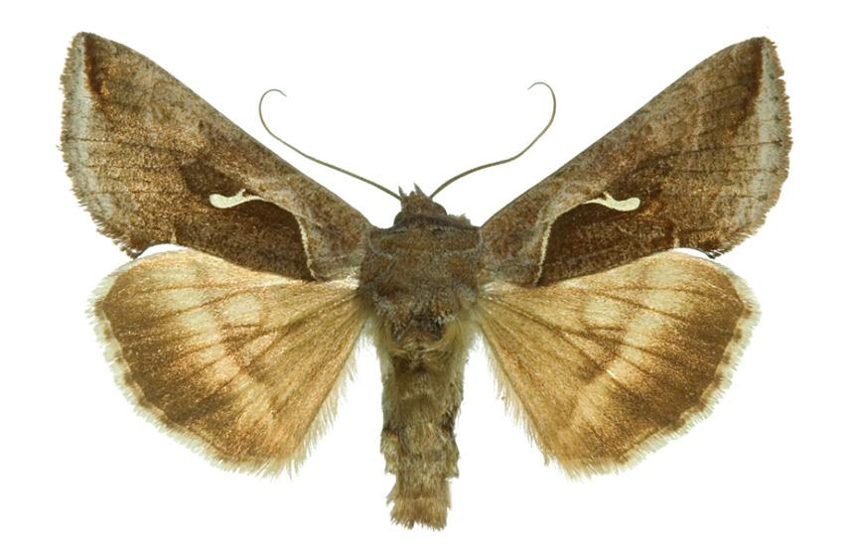
The Chrysalis Effect
By contrast, ‘ugly’ scientific findings are more likely to be hidden away.
X
X
‘Ugly’
data
‘Ugly’
scientific paper
File drawer
P-hacking
HARKing
O’Boyle et al. (2014)
Notes:
This is something of a caricature – what’s the evidence?

Slide 3

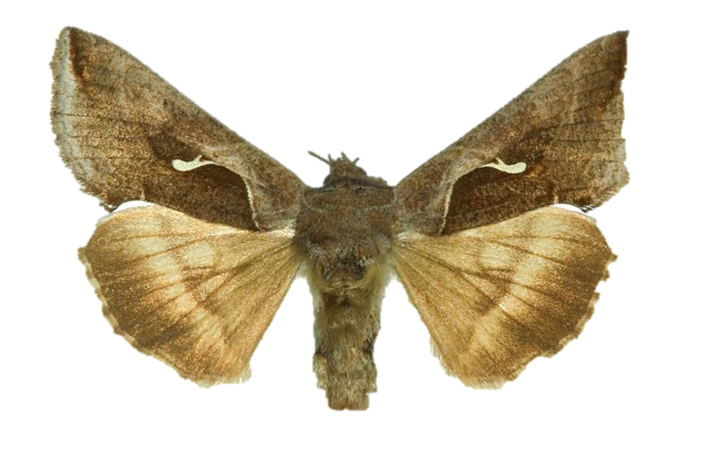

Pre-registration to disrupt the Chrysalis Effect
In theory, pre-registration holds you accountable so that p-hacking or HARKing are avoided or detectable. The paper is more credible, regardless of whether its an ugly moth paper or beautiful butterfly paper.
Pre-register
Data
Credible
scientific paper
P-hacking
HARKing
Notes:
How does this interact with the publication system?

